Slide 1
Module 2: Supervised Learning Network
4. Concept of Testing and Testing – Underfitting and Overfitting, Validation methods
EXTC – BE – Neural Network and Fuzzy Logic
Dr.Preeti Hemnani
Head and Associate Professor
Dept. of Electronics and Telecommunication,
SIES Graduate School of Technology

Slide 3
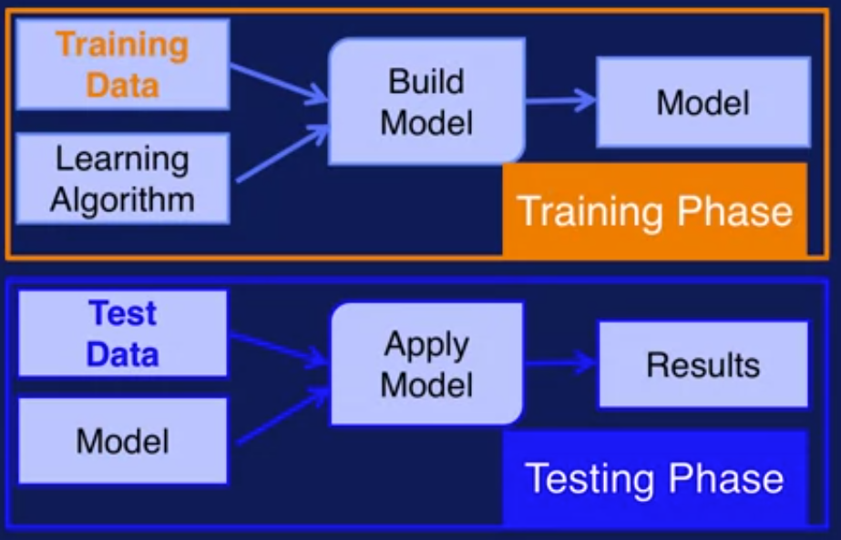
Training and Testing Phases:

Slide 5
Overfitting occurs when a statistical model or machine learning algorithm captures the noise of the data. Intuitively, overfitting occurs when the model or the algorithm fits the data too well. Specifically, overfitting occurs if the model or algorithm shows low bias but high variance. Overfitting is often a result of an excessively complicated model, and it can be prevented by fitting multiple models and using validation or cross-validation to compare their predictive accuracies on test data.
Underfitting occurs when a statistical model or machine learning algorithm cannot capture the underlying trend of the data. Intuitively, underfitting occurs when the model or the algorithm does not fit the data well enough. Specifically, underfitting occurs if the model or algorithm shows low variance but high bias. Underfitting is often a result of an excessively simple model.
Both overfitting and underfitting lead to poor predictions on new data sets.

Slide 6
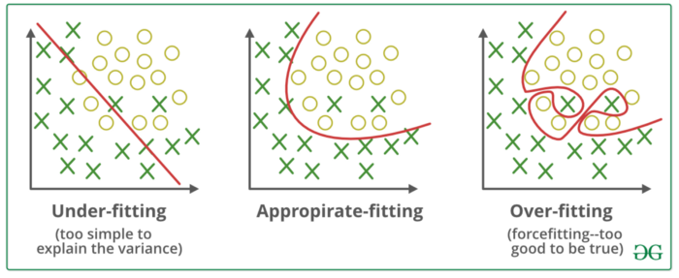
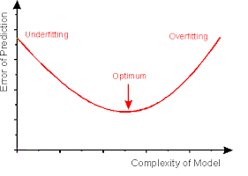
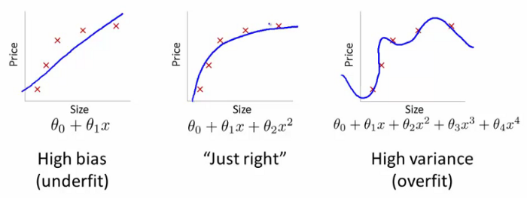
ax2 + bxy + cy2 + dx + ey + f = 0.
If b 2 − 4ac > 0 then the curve traces hyperbola. If b 2 − 4ac = 0 then the curve traces parabola. If b 2 − 4ac < 0 then the curve traces ellipse.

Slide 7
Generalization and Memorization
Memorization is the model’s ability to respond to the training set.
Generalization is the model’s ability to give sensible outputs to sets of input that it has never seen before.
A model that generalizes well is a model that is neither underfit nor overfit.
Underfitting is the case where the model has “ not learned enough” from the training data, resulting in low generalization and unreliable predictions.
Overfitting also leads to poor prediction.
Therefore a model with optimized performance is needed.

Slide 8
How to detect underfitting and how to avoid it?
A model under fits when it is too simple with regards to the data it is trying to model.
One way to detect such a situation is to use the bias-variance approach
More data will not generally help. It will, in fact, likely increase the training error. Therefore we should increase more features. Because that expands the hypothesis space. This includes making new features from existing features. Same way more parameters may also expand the hypothesis space.

Slide 9
How to detect Overfitting?
A key challenge with overfitting, and with learning algorithm in general, is that we don’t know how well our model will perform on new data until we actually test it.
To address this, we can split our initial dataset into separate training and test subsets. This method can approximate how well our model will perform on new data.
If our model does much better on the training set than on the test set, then we’re likely overfitting.
For example, if our model gives 95% accuracy on the training set but only 48% accuracy on the test set then it is overfit.

Slide 10
How to Prevent Overfitting
Detecting overfitting is useful, but it doesn’t solve the problem. We dnt know when to stop iterations.
Here are a few of the most popular solutions for overfitting:
Holdout Validation (random)
K-fold Cross-Validation
Random Sample Validation
Leave one out Validation
Leave p out Validation

Slide 11
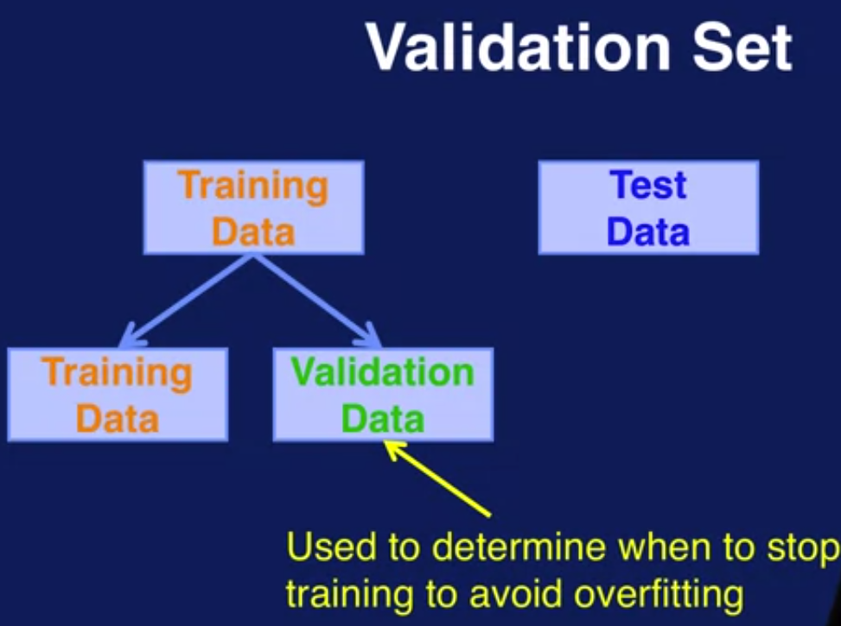
Datasets

Slide 12
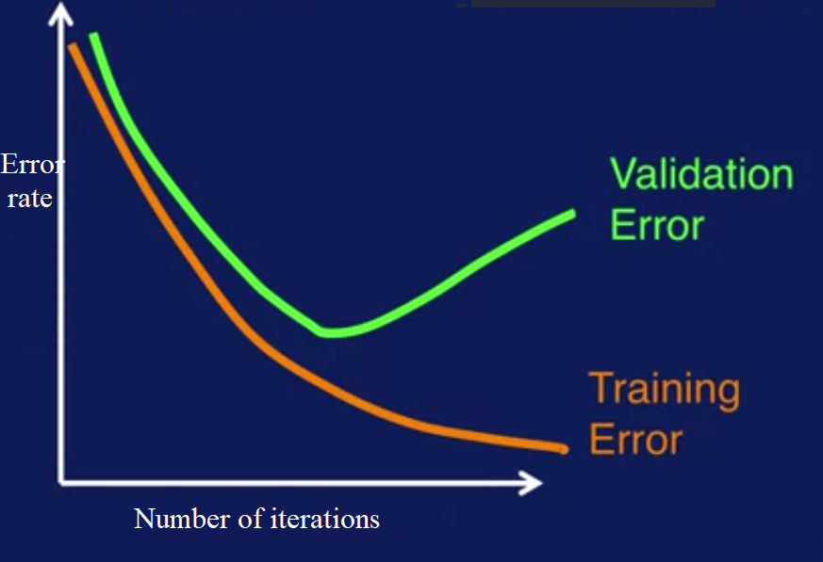
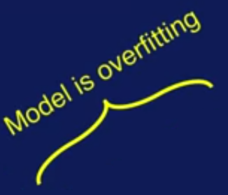
Validation

Slide 13

Datasets
Training Datasets –
A training dataset is a dataset of examples used for learning, that is to fit the parameters (e.g., weights)
The model is initially fit on a training dataset, that is a set of examples used to fit the parameters (e.g. weights of connections between neurons in artificial neural networks) of the model.

Slide 14
Validation Datasets –
A validation dataset is a dataset of examples used to tune the hyperparameters (i.e. the architecture) of a classifier.
the fitted model is used to predict the responses for the observations in a second dataset called the validation dataset. The validation dataset provides an unbiased evaluation of a model fit on the training dataset while tuning the model's hyperparameters

Slide 15
Testing Datasets –
A test dataset is a dataset that is independent of the training dataset, but that follows the same probability distribution as the training dataset.
the test dataset is a dataset used to provide an unbiased evaluation of a final model fit on the training dataset.

Slide 16
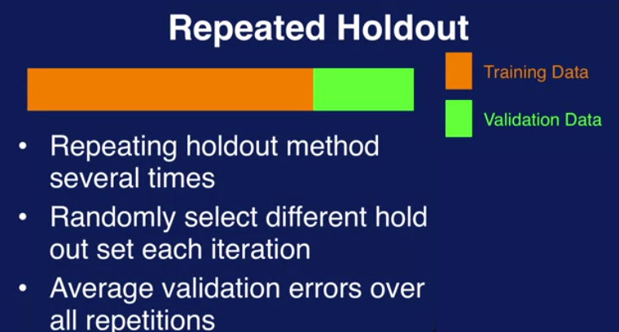
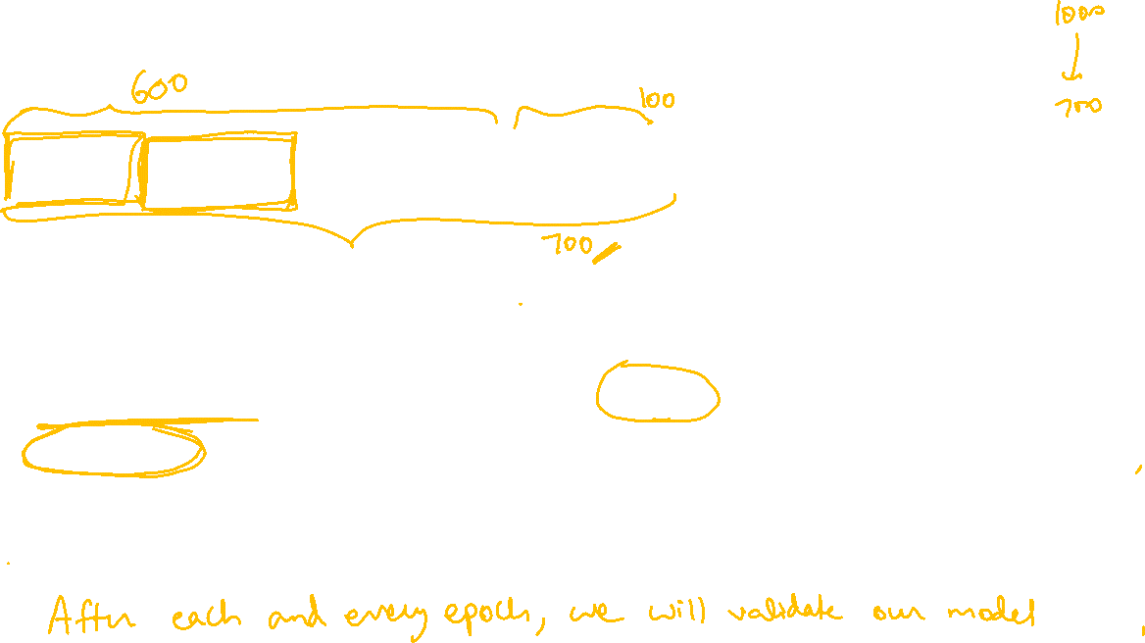

Slide 17
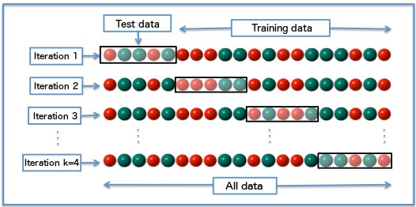
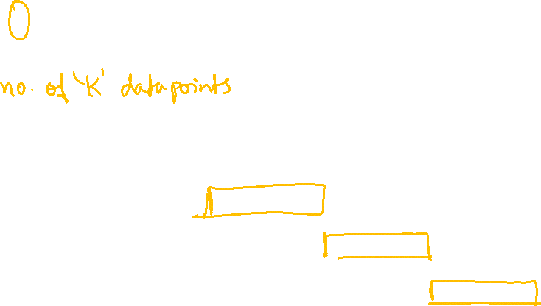
K-fold Cross-Validation: A standard way to find out-of-sample prediction error is to use 5-fold cross-validation.

Slide 18
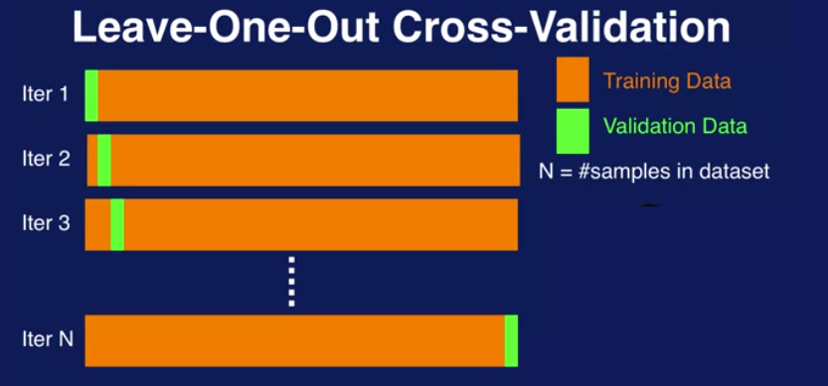

Slide 19
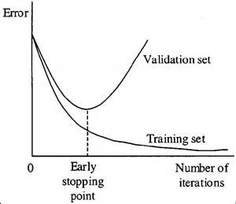
Early Stopping: Its rules provide us with guidance as to how many iterations can be run before the learner begins to over-fit.

Slide 20
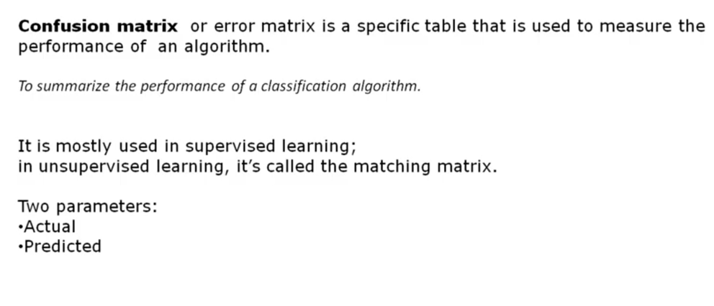
Confusion Matrix

Slide 21
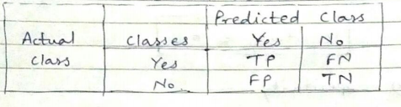
Confusion Matrix
Here, • Class 1 : Positive • Class 2 : Negative
Definition of the Terms: • Positive (P) : Observation is positive (for example: is an apple). • Negative (N) : Observation is not positive (for example: is not an apple). • True Positive (TP) : Correctly classified or detected :Observation is positive, and is predicted to be positive.
• False Positive (FP) : InCorrectly classified or detected: Observation is negative, but is predicted positive. • True Negative (TN) :Correctly rejected.Observation is negative, and is predicted to be negative.
• False Negative (FN) : InCorrectly rejected .Observation is positive, but is predicted negative.

Slide 22
Confusion Matrix
Classification Rate/Accuracy:
Classification Rate or Accuracy is given by the relation:
Accuracy = (TP + TN) / (TP + TN + FP + FN)
Recall:
Recall can be defined as the ratio of the total number of correctly classified positive examples divide to the total number of positive examples. High Recall indicates the class is correctly recognized (small number of FN).
Recall = TP / (TP + FN)
Precision: To get the value of precision we divide the total number of correctly classified positive examples by the total number of predicted positive examples. High Precision indicates an example labeled as positive is indeed positive (small number of FP). Precision is given by the relation:
Precision = TP/ (TP + FP)

Slide 23
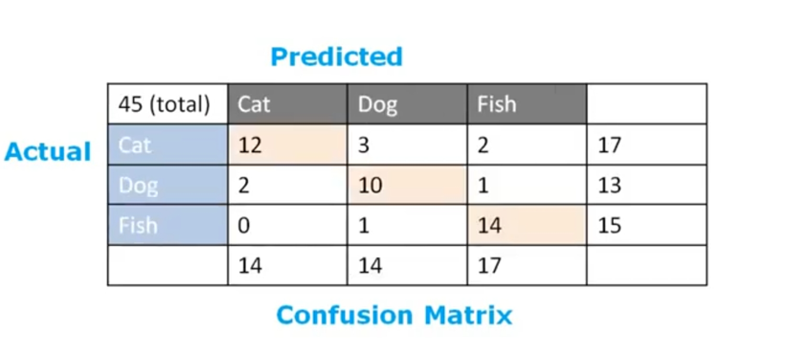
Problem- find Accuracy

Slide 24
Thank You!
(preetih@sies.edu.in)

